Slide 1
Enabling Academic Research:
Open Research Tools and Services on Microsoft Platforms
Tony Hey
Corporate Vice President
Microsoft External Research

Slide 2














Tony Hey – An Introduction
Commander of the British Empire
Notes:
1970: D.Phil. in Theoretical Physics, Oxford, UK
Research at Caltech, CERN, MIT and IBM Research
1974 -1985: Professor in Physics at Southampton
1985 – 1999: Professor of Parallel Computing in Electronics and Computer Science at Southampton
1994 – 1999: Head of Electronics and Computer Science
1999 – 2001: Dean of Engineering
1996 – 2001: Director of Southampton Innovations Ltd.
2001 – 2005: Director of UK e-Science Program for the UK Office of Science and Technology
2005 – present: Corporate Vice President for Microsoft External Research

Slide 3

Emergence of a Fourth Research Paradigm
Thousand years ago – Experimental Science
  Description of natural phenomena
Last few hundred years – Theoretical Science
  Newton’s Laws, Maxwell’s Equations…
Last few decades – Computational Science
  Simulation of complex phenomena
Today – Data-Intensive Science
  Scientists overwhelmed with data sets
  from many different sources
    Data captured by instruments
    Data generated by simulations
    Data generated by sensor networks
  eScience is the set of tools and technologies
  to support data federation and collaboration
    For analysis and data mining
    For data visualization and exploration
    For scholarly communication and dissemination
Astronomy has been one of the first disciplines to embrace
data-intensive science with the Virtual Observatory (VO),
enabling highly efficient access to data and analysis tools
at a centralized site. The image shows the
Pleiades star cluster form the Digitized Sky Survey
combined with an image of the moon,
synthesized within the WorldWide Telescope service.
Science must move from data to information to knowledge
With thanks to Jim Gray
(With thanks to Jim Gray)

Slide 4



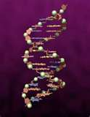
Worldwide External Research
Community and Geographic Outreach
Advanced Research Tools and Services
Notes:
Microsoft External Research Core Computer Science advances the state of the art in computer and computational sciences, focusing on ground-breaking research that is high-impact and disruptive.
Microsoft External Research Earth, Energy and Environment applies technology to improve our understanding of the world around us enabling insights into highly complex domains such as energy efficiency, climate modeling and oceanography.
Microsoft External Research Education and Scholarly Communication efforts are focused on the academic community’s use of technology on a daily basis to conduct research and how to better teach higher education students around the world.
Microsoft External Researching Health and Wellbeing is helping researchers explore technologies that advance healthcare solutions and empower people to make better choices about their health.

Slide 5
Accelerating time to insight with Advanced Research Tools and Services
Our goal is to accelerate research by collaborating with academic communities to create open tools and services based on Microsoft platforms and productivity software.
We help scientists spend less time on IT issues and more time on discovery.

Slide 6
Tools and Technologies for the Scientific Community
Zentity
Open tools and services
based on Microsoft platforms
and productivity software
Project Trident
Creative Commons
Research Information Center
NodeXL

Slide 7
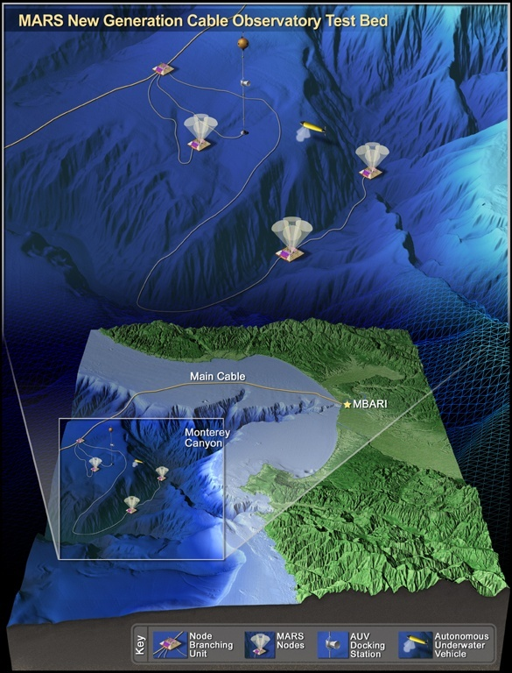
Project Trident: A Scientific Workflow Workbench
Accelerating the pace of discovery
Makes it easier for scientists to ingest and make sense of data
Get answers to questions at a rate not previously possible
Capture provenance
Scientists in data-intensive fields such as oceanography, astronomy, environmental science and medical research can use these tools to manage, integrate and visualize volumes of information.
The tools are available as no-cost downloads to academic researchers and scientists
Example:
Scientific workflow workbench
to automate the data processing
pipelines of the world’s first plate-scale
undersea observatory.
University of Washington and Monterey Bay Aquarium Research Institute
What once required weeks
or months of custom coding,
now takes just hours

Slide 8

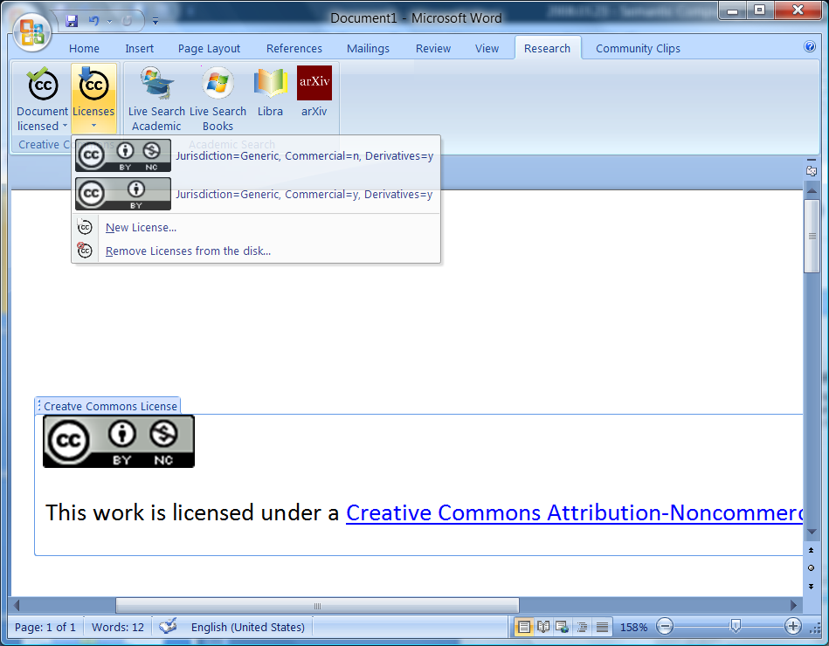
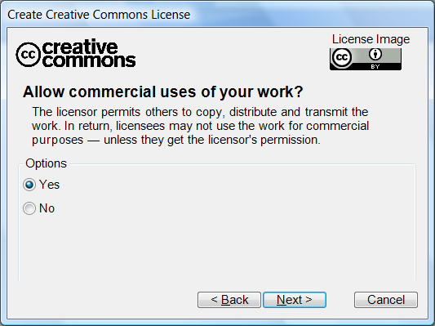
Creative Commons Add-in for Office 2007
Intent: Insert Creative Commons licenses from within Office 2007
Services: Integrates with Creative Commons Web API to create new licenses
Relationships: license information stored as RDF XML within the document OOXML
http://ccaddin2007.codeplex.com

Slide 9
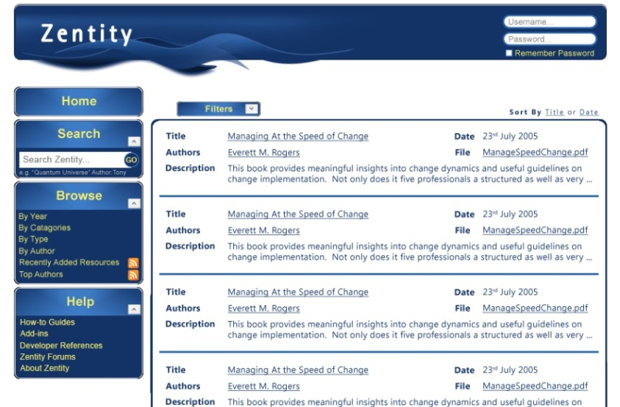
Zentity – a Research Output Repository Platform
Native support for RSS, OAI-PMH, OAI-ORE, AtomPub and SWORD
Default web UI with CSS support and custom ASP.Net controls
Flexible data model enables many scenarios and can be easily extended over time
A semantic computing platform to store and expose relationships between digital assets
http://research.microsoft.com/zentity/

Slide 10
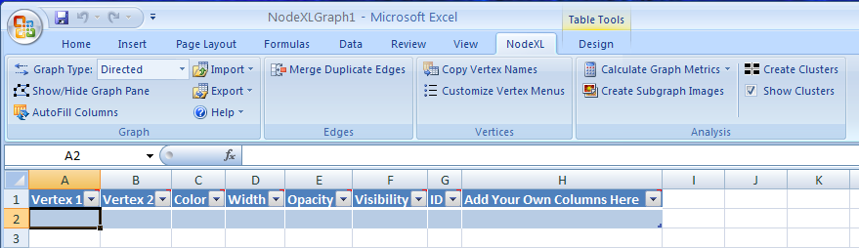
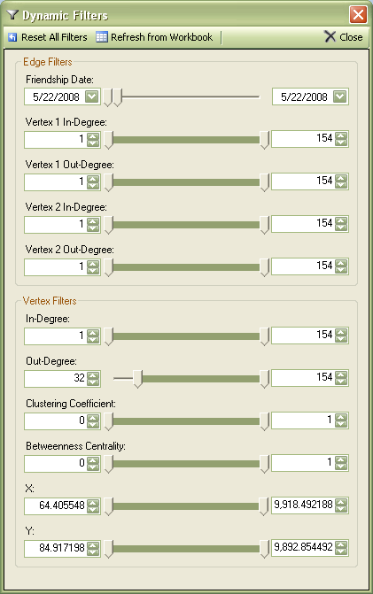
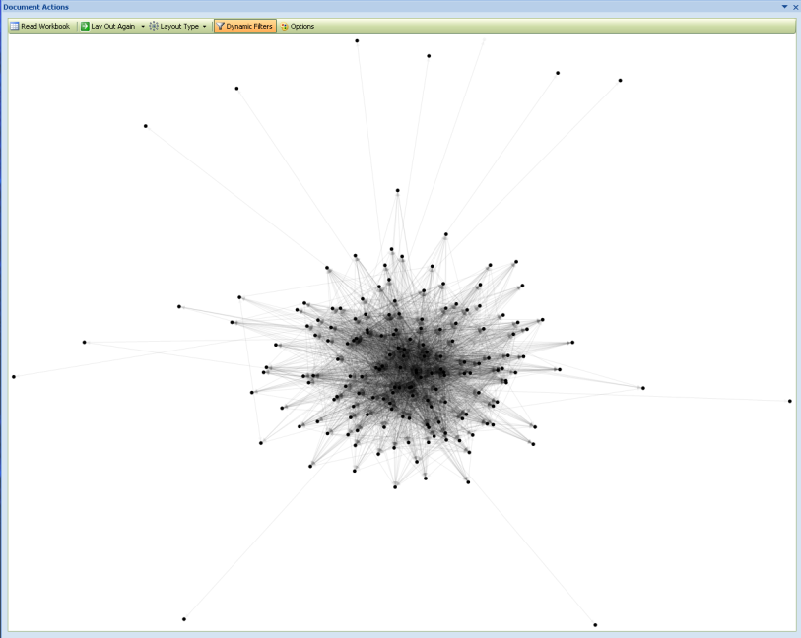
Node XL
Network analysis and visualization tool
Network analysis is of growing importance in academic, commercial, and Internet social media contexts
Existing Social Network Tools are challenging for many novice users
Tools like Excel are widely used
Leveraging a spreadsheet as a host for Social Network Analysis lowers barriers to network data analysis and display
Leverage spreadsheet for storage of edge and vertex data
Apply dynamic filters to the data

Slide 11
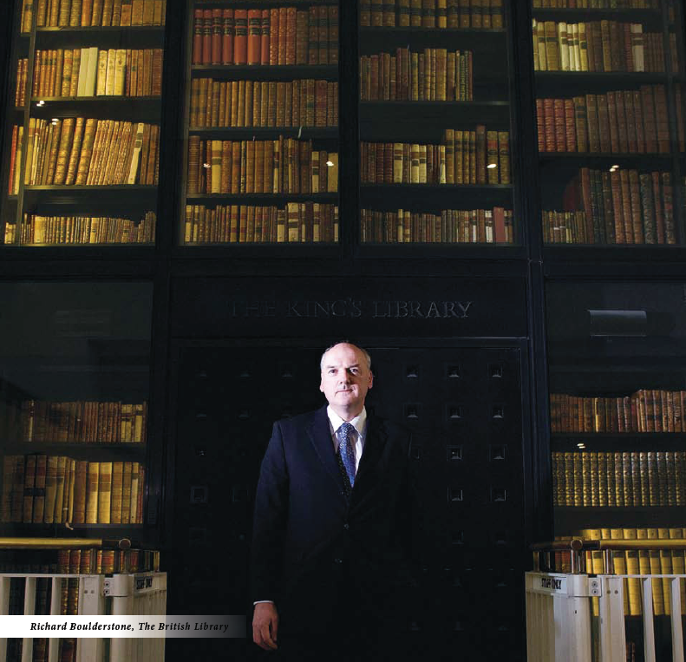
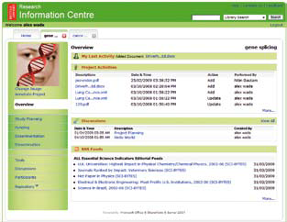
Research Information Center (RIC)
Virtual Research Environments: Tackling Global Challenges Across Scientific Disciplines
Collaboration and information sharing among researchers are among the most important but challenging aspects of scientific research.
In recent years, scientists have begun using “virtual research environments” to exchange information with colleagues in specific areas of study.
Microsoft Research and The British Library are teaming up to build the Research Information Centre
A tool that can help researchers tackle global challenges across a broad range of scientific disciplines.

Slide 12
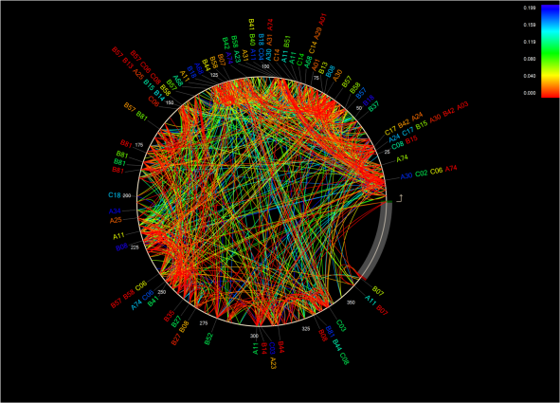
PhyloD as an Azure Service
Statistical tool used to analyze DNA of HIV from large studies of infected patients
PhyloD was developed by Microsoft Research and has been highly impactful
Small but important group of researchers
  100’s of HIV and HepC researchers actively use it
  1000’s of research communities rely on these results
Cover of PLoS Biology
November 2008
Typical job, 10 – 20 CPU hours with extreme jobs requiring 1K – 2K CPU hours
  Very CPU efficient
  Requires a large number of test runs for a given job (1 – 10M tests)
  Highly compressed data per job ( ~100 KB per job)
Highlights Windows Azure’s potential for agile deployment of science-related services that scale
Courtesy of Roger Barga

Slide 13
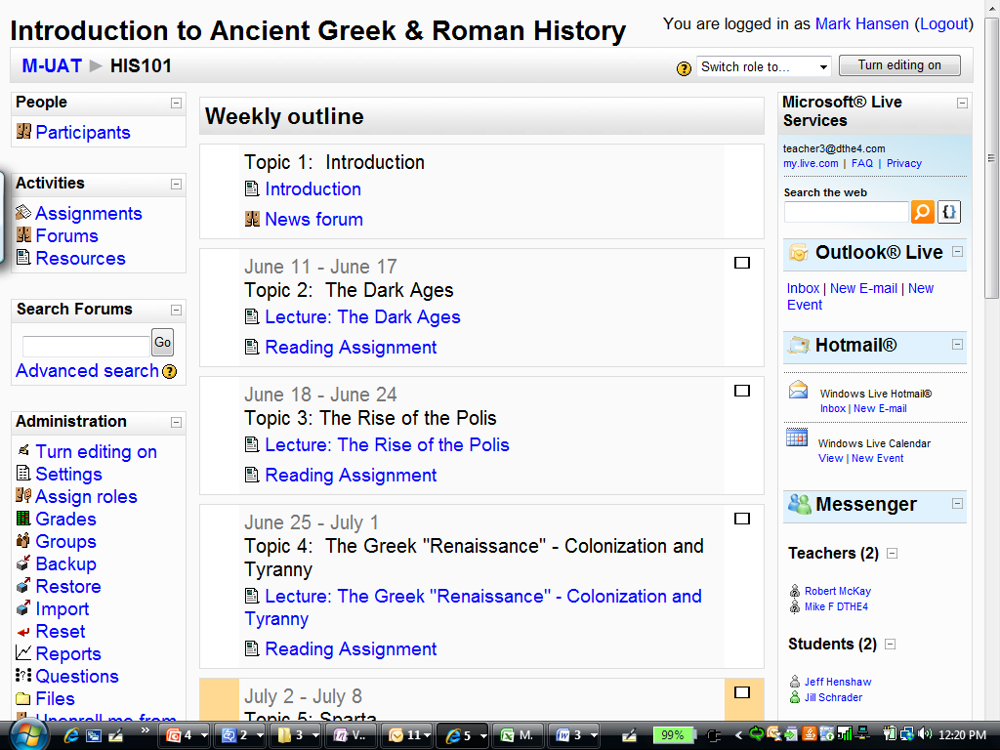
Free Microsoft Live@EDU Services In Moodle
  Moodle is an Open Source Learning Management System used in thousands of schools worldwide
  Microsoft Live@EDU provides free communications, collaboration and productivity tools to teachers and students
  Email
  IM
  Calendaring
  MSN Alerts
  Bing Search
  The “Microsoft Live@EDU Plug-In for Moodle” enables these Live@EDU services to be accessed via a single sign-on process within Moodle; and is available under the GPLv2
Notes:
The free Microsoft Live Service Plug in for Moodle allows educators, students and institutions simple, direct access to their Live@Edu email, calendar, MSN buddy lists, and MSN Alerts from within the Moodle learning management platform, using one user name and password to log in to both.
The Moodle learning management system is a leading learning management system used in thousands of schools and millions of students worldwide.

Slide 14
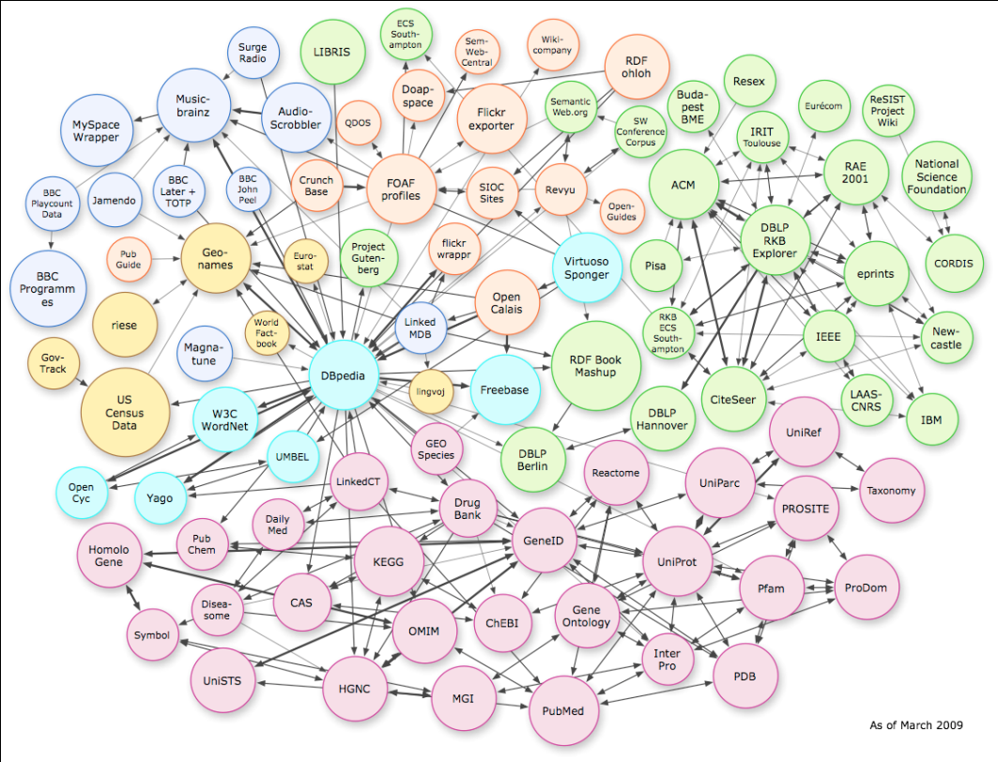
A world where all data is linked …
Data/information is inter-connected through machine-interpretable information (e.g. paper X is about star Y)
Social networks are a special case of ‘data meshes’
A knowledge ecosystem:
  A richer authoring experience
  An ecosystem of services
  Semantic storage
  Open, Collaborative,
  Interoperable, and Automatic
Attribution: Chris Bizer

Slide 15






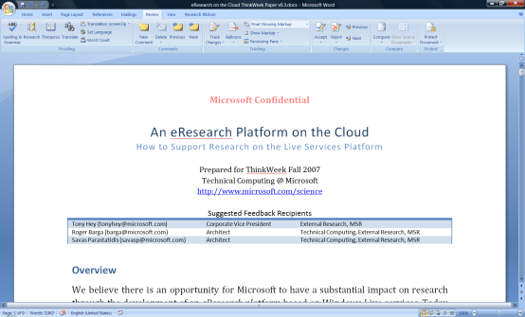

…and stored/processed/analyzed in the Cloud
visualization and analysis services
Vision of Future Research
Environment with both
Software + Services
scholarly communications
domain-specific services
search
books
citations
blogs &
social networking
Reference management
instant messaging
Project management
identity
mail
notification
document store
storage/data services
The Microsoft Technical Computing mission to reduce time to scientific insights is exemplified by the June 13, 2007 release of a set of four free software tools designed to advance AIDS vaccine research. The code for the tools is available now via CodePlex, an online portal created by Microsoft in 2006 to foster collaborative software development projects and host shared source code. Microsoft researchers hope that the tools will help the worldwide scientific community take new strides toward an AIDS vaccine. See more.
knowledge management
compute
services
virtualization
knowledge discovery

Slide 16
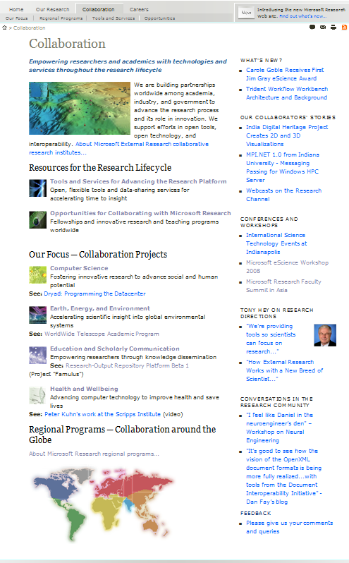
Where to download the tools research.microsoft.com/en-us/collaboration/tools
The site contains access and downloads of relevant open tools and resources for the worldwide academic research community. Examples of other open tools and services:
Computational Biology Toolkit
  Enables and accelerates fundamental advances in biology
F#
  Collaboration with the academic and research community on F#’s typed functional and object-oriented programming on the .NET platform
  Dryad; DraydLINQ
  Plug-ins for Office
  Ontology Add-in for Word
  Article Authoring Add-in for Word
  Chem4Word – Chemistry Drawing in Word
  Microsoft Electronic Journals Service
  Open XML Document Viewer
  Software Engineering Tools
Spec#: Program verifier for C# extended with design by contract
VCC: Program verifier for Concurrent C
PEX: automatic unit testing tool for .NET
CHESS: Unit testing tools for concurrent Win32 executable and .NET
Please come see us in the
Microsoft booth
#201

Slide 17


